Slide 1
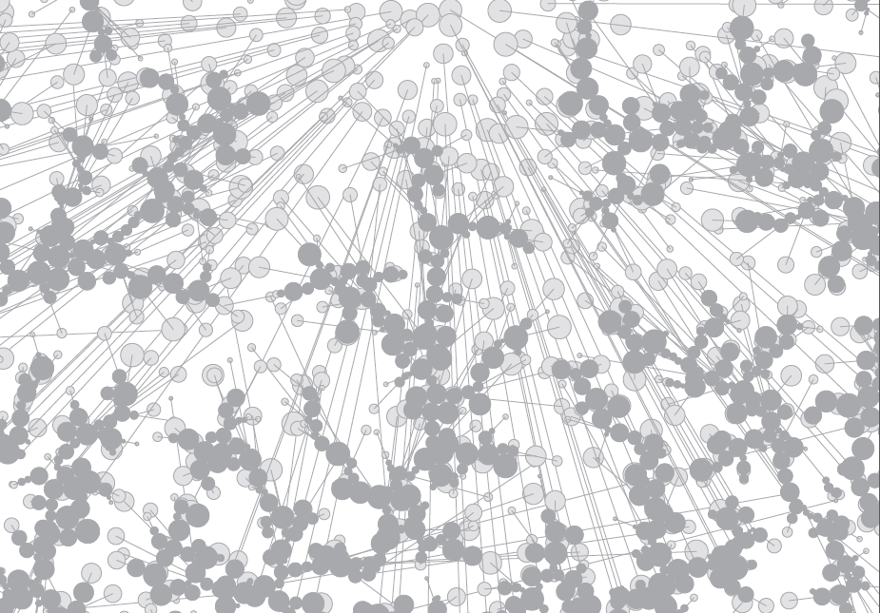
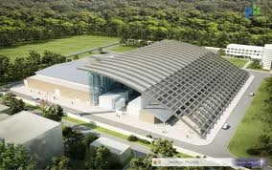
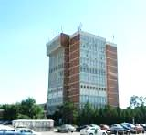
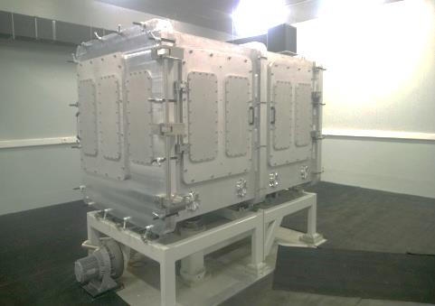
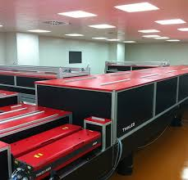
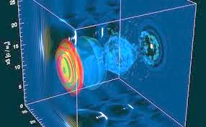
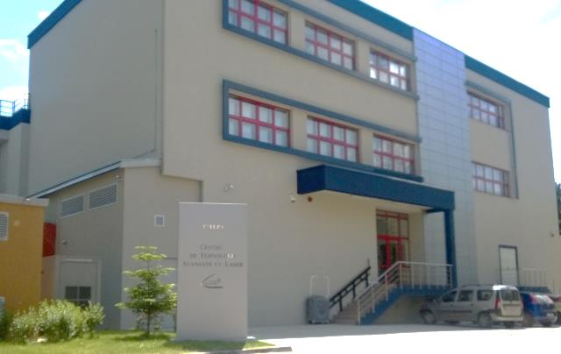
The “CLARA” Project
May 14, 2014

Slide 2
CLARA = THE EU CENTER OF EXCELLENCE IN LASERS AND RADIATIONS -
FUNDAMENTAL & APPLIED RESEARCH, INNOVATION, APPLICATIONS, TECHNOLOGY TRANSFER TO COMPETITIVE MANUFACTURING & MARKETING
“KEY ENABLING TECHNOLOGIES - KET” CLUSTER,
“MULTI - SMART SPECIALISATION” PROFILE
ROMANIA HAVE THE INCONTESTABLE RIGHT TO OBTAIN, TO BE NOMINATE & TO IMPLEMENT THIS PROJECT - DUE TO ITS:
SCIENTIFIC CAPABILITIES BASED ON PROFESSIONAL AND HUMAN VALUES OF MAGURELE NIRD’s RESEARCHERS ;
LEVEL OF TECHNOLOGICAL INVESTMENTS ON MAGURELE PLATFORM - PRIMARILY ELI-NP AND CETAL

Slide 3
GENESIS OF “CLARA” PROJECT (I)
June 2013 - March 2014:
"Brainstorming“and informal discussions in order to properly evaluate the unique potential of existing or under development equipment and facilities on Magurele Platform in the field of fundamental & applied scientific research "beyond the limits“, followed by technology transfer of the results to potentially large economic actors and SMEs - with :
European Commission: DG ENT, DG RTD, DG EMPL, DG REGIO;
European Defence Agency (EDA) - IAP3 Experts Group on lasers, optronics, sensors;
EESC - CCMI: Community entity that evaluates and develops strategies on various economic sectors under the request of EU Commission, EU Presidency and EuroParl;
Major international companies :AREVA, Airbus, Bayer, EADS, ThalesAleniaSpace etc.
Large european Clusters with innovation profile / KET: “Photonics” Belgium etc.;
“The European Round Table of Industrialists” - Brussels-based association whose members are the presidents of the most important 50 European companies ;
“Business Europe” & “CEEP - SIG” - the two largest EU employers’ organizations;
Investment Funds - interested in R&T activities from Romania and abroad.

Slide 4
GENESIS OF “CLARA” PROJECT (II)
January - Mai 2014
Defining the structure and optimal implementation method of “CLARA” project.
May 5, 2014 - The plenum of NIRD’s DGs unanimously approved the proposal regarding the implementation of CLARA project on Magurele Platform, Romania.
Starting the activities to obtain the approvals from Romanian authorities for promotion at EU level and implementation of CLARA project :
Prof. Dr.Tudor Prisecaru, Secretary of State, Ministry of National Education
Prof. Dr. Mihnea Costoiu, Minister Delegate for Higher Education, Scientific Research and Technological Development
Dr. Eugen Teodorovici, Minister of EU Funds
Starting the activities regarding the preparation of the written form of the project according with the KET’s standard procedure imposed by European Commission

Slide 5
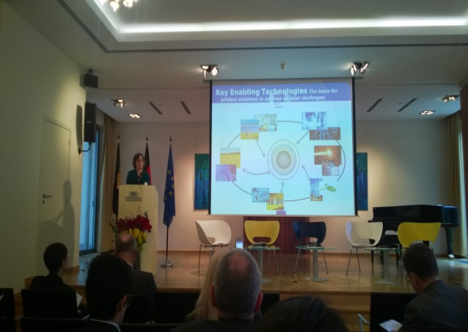

GENESIS OF “CLARA” PROJECT (III)
January - April 2014: PROMOTION IDEA ON THE EUROPEAN
February 16, 2014: Conference on "New Cluster Policies for Central Europe and beyond" at Representation Office of Baden Wurttemberg Land in Brussels: 5 major issues launched by European Commission on clusters’ policy:
Importance and priority of European Commission given to the KET - type clusters;
Allocating large sums to create new KETs in Member Countries;
Introducing the Smart Specialization concept in connection with KET’s promotion;
Defining the new type of CLUSTRAT clusters developed for Central Europe;
EC decision on CLUSTRAT direct transfer to countries located in the Danube Region.
IFIN-HH & INFLPR: individual meetings with representatives of EC & JRC to present the “CLARA” concept; launching the request on behalf of Magurele Platform to be nominate as the first recipient of such a transfer.

Slide 6
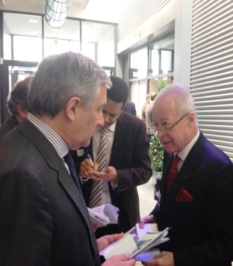
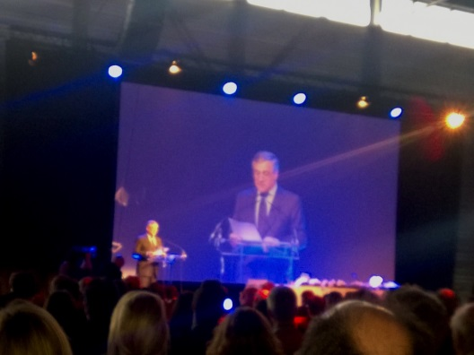
GENESIS OF “CLARA” PROJECT (IV)
February 17, 2014 - Mr Antonio Tajani, VP of the European Commission, launched the new “EU Strategy for Growth 2020” la La Louviere, Belgia.
During a working meeting with VP Tajani, the delegation IFIN-HH & INFLPR presented CLARA Multi - KET concept as a Romanian contribution supporting implementation of the new strategy of European Commission; VP Tajani was assisted by Mr. Daniel Calleja Crespo, Director General of DG ENTR;
Mr. Tajani fully agrees the CLARA concept, stating that this is the kind of action that should be promoted as a priority according with the new European strategy, asking Mr. Crespo to closely follow CLARA promotion;
May 5, 2014 : The plenum of NIRD’s General Directors unanimously approved the proposal on implementation of CLARA project on Magurele Platform, Romania

Slide 7
WHY A KET CLUSTER?
KETs - systemic importance to the future structure of the EU economy :
• The current global market volume generated by : € 646Bn;
• Substantial growth forecast : ~ 8% of EU GDP in 2015;
•Accelerate innovation to downstream markets;
• Applications in multiple industries and in a wide variety of economic sectors: aerospace, automotive, food, chemical and petrochemical, defense and security, electronics, energy, health, new materials, IT etc.
• Extremely large size of the markets created support for significant increases in the number of new employees and thus reduce youth unemployment
• Important role in traditional sectors and emerging industries - both large companies and SMEs;
☞ Generating advanced technology and competitiveness in all industrial and economic policies, including key sectors and cutting - edge areas.

Slide 8
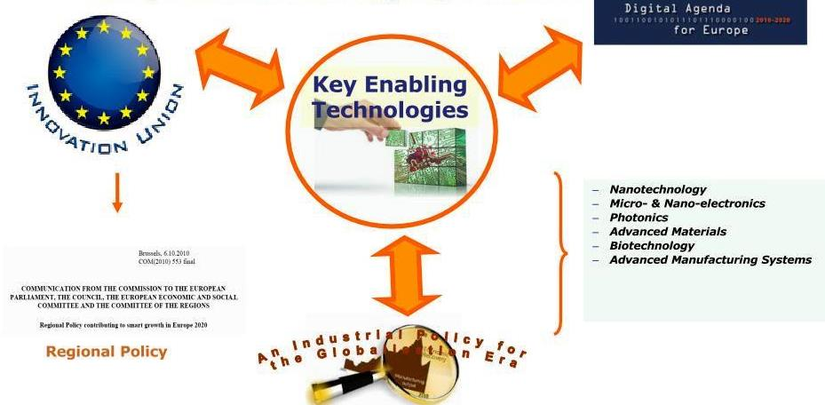
THE MAJOR ROL OF KET CLUSTERS IN THE COMMUNITY POLICY
AGENDA “EUROPE 2020” AND ITS FLAGSHIP INITIATIVES
Industrial Policy Priorities
CLARA
covers all six
areas!

Slide 9
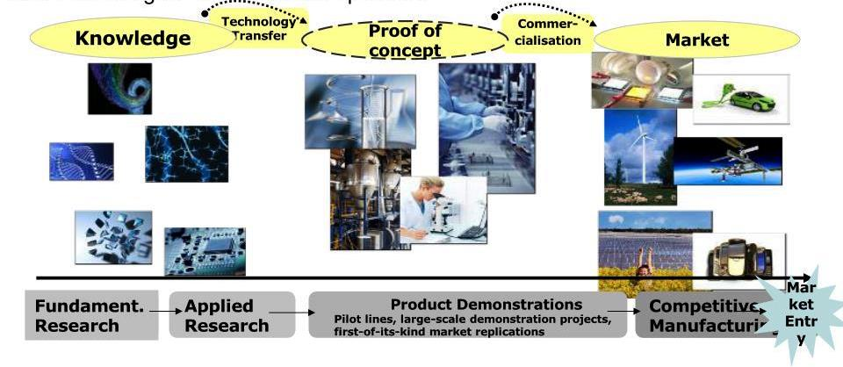
VALUE - ADDED CHAIN GENERATION IN KET STRUCTURES
KET policy focused on innovation allows most economic sectors and all regions to apply for funding their strategic development activities.
KET policy ensure EU funding the entire chain - from basic research to the start of mass manufacturing of innovative products.

Slide 10
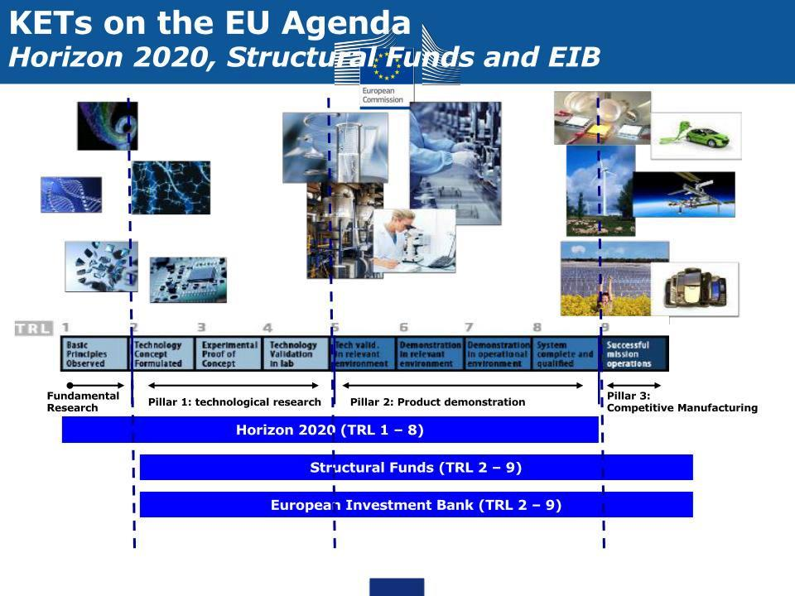
FUNDING POLICY FOR KET (I)

Slide 11
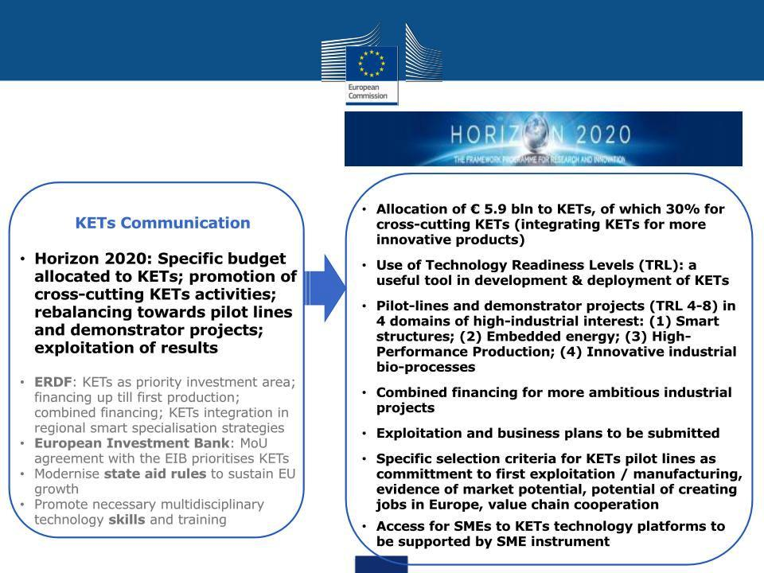
FUNDING POLICY
FOR KET (II)

Slide 12
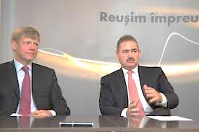
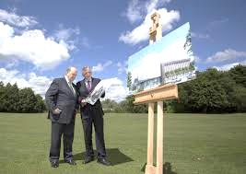

FUNDING POLICY FOR KET (III)
MoU between the Commission and the EIB financing KET - 27.02.2013
Parties mutually recognize KET priority role on innovation and development structures at EU level
• agrees to align the policies relating KETs and support synergies;
• agrees to cooperate providing additional financial support by increasing EIB allocations to KET in relation to the amounts awarded in 2012;
• After signing, EIB loans granted KET increased significantly in 2013 to € 4.4 Bn - from € 2.7 Bn in 2012.

Slide 13
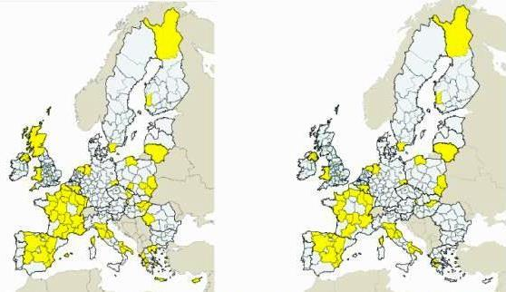
MAP OF INTENTIONS OF REGIONS AND MEMBER STATES
ON PARTICIPATION IN “SMART SPECIALISATION"
More than 160 regions from all MS already registered in the database.
2 of 3 recorded regions mention as a priority the development of KETs.
Over 20% of total R&D - type priorities refers to KETs.
Registered in database
With KET as priority

Slide 14
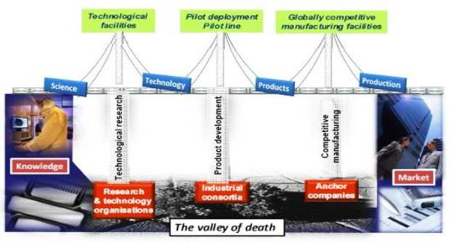
CHOOSING THE OPTIMAL STRUCTURE FOR “CLARA”
Structure agreed by the Commission: the “THREE PILLARS’ BRIDGE“ crossing the "VALLEY OF DEATH“.
Europe is strongly positioned both ends of the “Bridge" - pillars 1 and 3;
There is a weak point between segments "Technology" and "Production" - Pillar 2;
The excellent results of fundamental research and technology must be continued by strengthening the “Product Development” pillar (prototypes, demonstrators, pilot lines, etc.) in order to increase the competitiveness of final products.

Slide 15
THE STRUCTURE OF “CLARA” (I)
COMPONENT 1: "SCIENCE - FUNDAMENTAL AND APPLIED RESEARCH, MATHEMATICAL MODELING, PRIMARY EXPERIMENTS, LABORATORY TEST”
- NATIONAL RESEARCH INSTITUTES (NRI), UNIVERSITIES - BOTH FROM ROMANIA (RO) & FOREIGN COUNTRIES
COMPONENT 2: “TECHNOLOGY RESEARCH AND EVALUATION OF EXPERIMENTAL MODELS"
- NRI, R&D DEPARTAMENTS OF MAJOR ROMANIAN AND FOREIGN COMPANIES, PROFESSIONAL SMEs
COMPONENT 3: “TESTING THE NEW TECHNOLOGY TO INCREASE THE QUALITY STANDARD & RELIABILITY OF NEW PRODUCTS: DEMONSTRATORS, PROTOTYPES, PILOT LINES”
- NRI, RO & FOREIGN COMPANIES, PROFESSIONAL SMEs

Slide 16
THE STRUCTURE OF “CLARA” (II)
COMPONENT 4: “TRANSFER OF NEW RELIABLE TECH-NOLOGY FOR MASS PRODUCTION & GLOBAL USE"
- PARTICIPANTS: MAJOR COMPANIES FROM ROMANIA AND ABROAD, POOLS OF PROFESSIONAL SMEs - HORIZONTAL SUPPLIERS: PROFESSIONAL SMEs.
COMPONENT 5: “MARKETING, PROMOTION, TRADE, PUBLIC RELATIONS“ - “CLARA” CENTRAL ADMINISTRATION, MAJOR COMPANIES FROM ROMANIA AND ABROAD, NRI, INVESTMENT FUNDS, PROFESSIONAL SMEs
COMPONENT 6: “GENERAL SERVICE PROVIDERS FOR “CLARA” ACTIVITIES AND MEMBERS”
- SMEs - SERVICE PROVIDERS PROFILE.

Slide 17
THE STRUCTURE OF “CLARA” (III)
COMPONENT 7: “INVESTMENT FUNDS SPECIALIZED IN R&D, INNOVATION AND TECHNOLOGY TRANSFER ACTIVITIES"
- INVESTMENT FUNDS FROM RO, EU, USA, GCC, FAR EAST.
COMPONENT 8: ‘‘HUMAN RESOURCES - EDUCATION, QUALIFICATION, TRAINING, MICRO -PRODUCTION"
- APPLYING FACILITIES OF EU “APPRENTICESHIP” PROGRAM
- BUILDING A TECHNOLOGICAL BASE & FACILITIES
FOR PROFESSIONAL TRAINING AND MICROPRODUCTION. - IN CHARGE: “CLARA “CENTRAL AD-TRATION & MEMBERS
COMPONENT 9: THE CENTRAL ADMINISTRATION - GENERAL MANAGEMENT, GLOBAL STRATEGIES, RELATION WITH INVESTORS, INTERCORRELATION ACTIVITIES BETWEEN MEMBERS AND WITH EU & INT’L ORGANIZATIONS, SOCIETAL DUTIES.

Slide 18
BUC. – ILFOV S. DEV. REGION
PPP
C L A R A
PPP
MAGURELE CITY COUNCIL
R&D
INSTI-TUTES
UNI-VERSI-TIES
LARGE COMPANIES
INVEST-MENT FUNDS
CLUS-TER SMEs PROF.
CLUS-TER SMEs SERV.
+
RO
IFIN - HH
INFLPR
INFIM etc.
RO
UPB
BUC. UNIV.
TM UNIV. etc.
RO
ROMAERO
DACIA
ELMG etc.
RO
SIF I
SIF IV
etc.
RO
RO
KET MAJOR ADVANTAGE FOR LARGE COMPANIES: Joint teams of engineers and scientists working together from the early stage of RDI activities.
FOREIGN INSTI-TUTES
FOREIGN
UNIVER-SITIES
FOREIGN COMPA-NIES
INT’L VENTURE CAPITAL

Slide 19
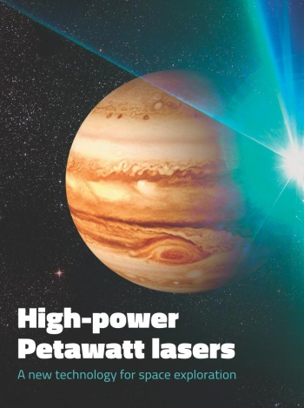
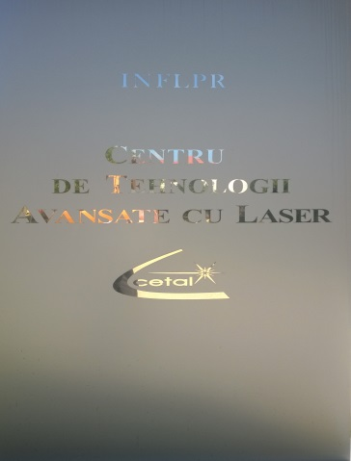
WHAT CAN “CLARA” OFFER TO ITS MEMBERS?
ELI-NP: THE WORLD MOST POWERFUL LASER(20 PW)
Owner: IFIN - HH (NIPNE - HH)
Operational in 2017
Investment: 386M Euro (EU funds & RO)
2. CETAL: ACTUALLY THE SECOND MOST POWERFUL LASER IN THE WORLD (1 PW)
Property of INFLPR
Operational: June 2014
Investment: 58M Euro (exclusive RO funds)

Slide 20
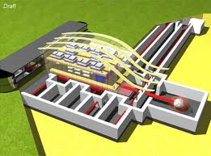

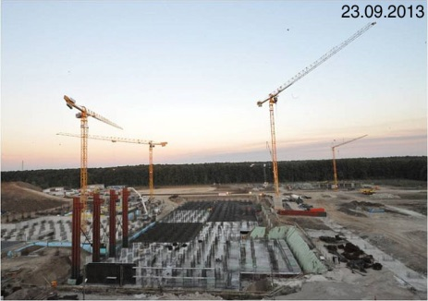
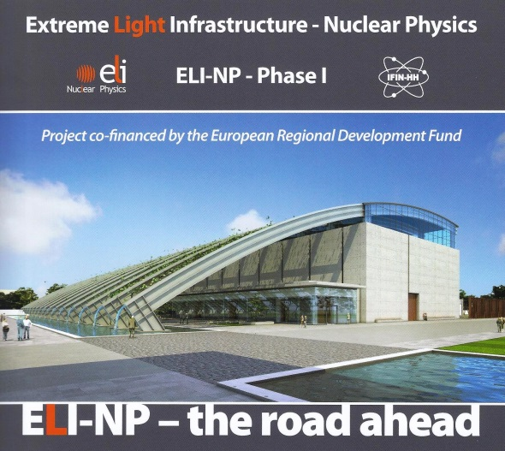
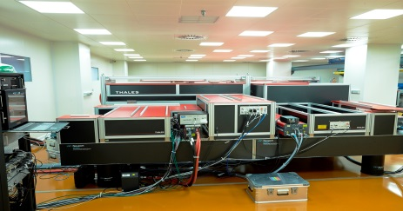
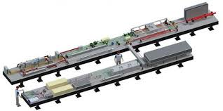
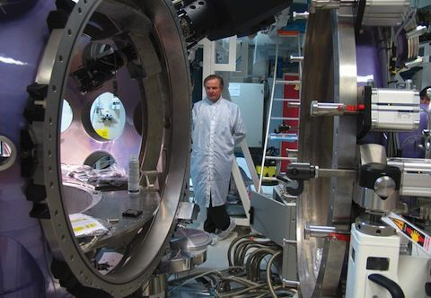
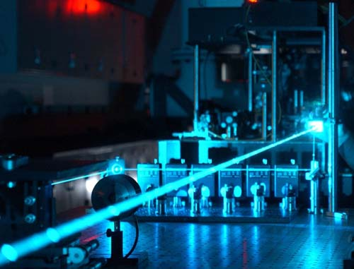

ELI-NP - THE MOST POWERFUL LASER IN THE WORLD: 20 PW
EXTREME LIGHT INFRASTRUCTURE - NUCLEAR PHYSICS

Slide 21
THE 20 PW ELI-NP LASER
www.eli-np.ro www.eli-dc.eu
Construction ELI-NP at Magurele: area of ​​over 68,000 sq.m. - basement, ground and five floors.
Timeframe for investment: 55 months.
ELI-NP project cost: 386M Euro;
Funding: EU-83% by ERDF; Romanian Gov’t supports 17%;
Running costs approx. equal to the current operating costs of a large national institute of size IFIN-HH;
Funding will be provided in research budget of Romania, the countries participating in the ELI, by national and international research projects and infrastructure access charges paid by companies that will conduct research.

Slide 22
THE 20 PW ELI - NP LASER PERFORMANCES
Ultra high power laser system generated by two laser beams coherent 10 PW; intensities of electric fields 10²³ - 10²⁴ W/cm² or 10¹⁵ V/m;
γ radiation beam intense and shiny (10¹³γ/s) with unique properties in the world, with a bandwidth of 0.1% and power up to Eγ> 19 MeV;
Infrastructure will create a new European laboratory with a wide range of scientific areas, covering fundamental physics frontier, nuclear physics and astrophysics, materials science, life sciences - mainly medicine and pharmacology.

Slide 23
ELI - NP: MAJOR POTENTIAL APPLICATIONS
Applications in nuclear materials, radioactive waste management and processing, generation of new materials, biotechnology, energy, pharmacology, advanced medical treatments;
A new laser acceleration mechanism allows treatment of fundamental problems of astrophysics, e.g. producing heavy elements with extremely high specific gravity in the universe;
γ beams for remote determining the distribution of isotopes of nuclear material or radioactive waste by the method of nuclear resonance fluorescence (NRF).

Slide 24
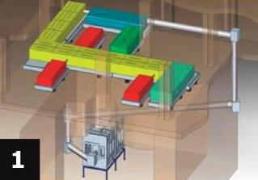
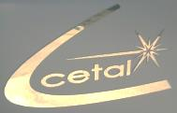
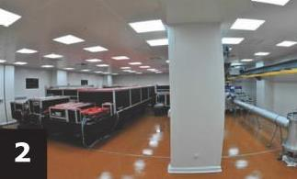
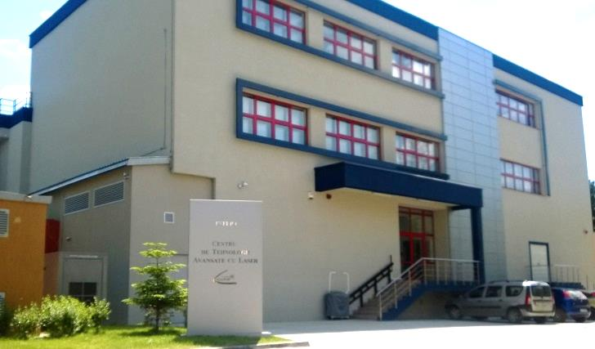
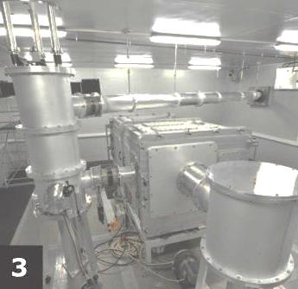
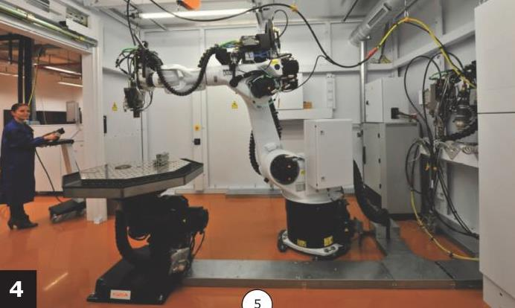
CETAL: ADVANCED LASER TECHNOLOGY CENTER
Layout of the 1 PW laser, beam transport line, interaction chamber.
1 PW laser room
Interaction chamber and beam transport line
Complex, high precision, gas assis-ted macro-processing equipment for 3D cutting, drilling, welding, coating

Slide 25
CETAL STRUCTURE (I)
LAB 1: FRONTIER RESEARCH - INTERACTIVE MATTERS - LASER BEAM HYPERINTENSE
Features:
Fs laser pulses with maximum pulse power of 1 PW;
Vacuum interaction chamber with a parabolic mirror to focus the laser radiation;
Vacuum transmission line from the exit of the laser compressor to the reaction chamber;
Equipment for detection of reaction products (electron, neutron and proton beams, ion beams, X & γ rays).

Slide 26
CETAL STRUCTURE (II)
LAB 2: ADVANCED TECHNOLOGIES THROUGH PROCESSING photon laser - made ​​up of two modules:
1. Macro-processing module equipped with an integrated multifunctional optical fiber laser beam made ​​by interconnecting several lasers and materials processing machines and computer-assisted correlation of their operation depending on the particular material and complexity of the piece.
3D macro-processing operations of materials, surface treatments
(hardening , alloying , cladding) - such as :
repair operations (reconstruction) worn regions (edges, sides etc.) of injection molds, casting molds etc. .
cutting and welding metal parts with a high degree of accuracy.
surface alloying treatments using the metal powders filler (WC, TiC ) or wired for forging and injection molds, trees, etc.
welding and cutting operations of precision metallic materials of various thicknesses and types of melting or high thermal conductivity - as precision masks made by copper or alluminium.

Slide 27
CETAL STRUCTURE (III)
2. Module “Micro- and nano-processing” has a number of lasers and laser systems to generate and process structures and materials in the dimensional range of μm & nm Tunable 1 KW CO2 laser photochemistry for R&D of nano-materials (tuning range from 9.2 to 10.8 μm, pulse operation: CW < 1 KHz);
Fs laser installation for high-resolution 3D lithography;
Ps laser for micro-processing;
Scanner with accessories for 3 different wavelengths.
LAB 3: PHOTONICS INVESTIGATIONS - FEATURES:
Laser system for vibration and shock testing;
THz spectrometer, Raman spectrometer ;
Tunable lasers operating in ps pulses ;
Optical frequency synthesizer based on “Frequency Comb" technology;
Tunable lasers operating in ns pulses (UV - near IR);
Lambdameter and spectrum analyser ;
Thermographic chambers.

Slide 28
AREA OF APPLICATIONS OF ELI-NP (I)
-Studying the phenomena currently anticipated theoretically or mathematical modeling, such as vacuum birefringence and create pairs of particles-antiparticles in intense electric fields using giant laser power. The results could change forever view the world in which we live, bringing confirmation or denial of fundamental assumptions.
New approaches to current extremely expensive anti-CANCER therapies by using proton - and electron - beams accelerated by high power laser radiation.

Slide 29
AREA OF APPLICATIONS OF ELI-NP (II)
- To improve the production efficiency in the area of new radioisotope radiation therapy and chemotherapy using the excellent performances of a new Platinum radioactive isotope;
Applications in materials physics: studying the behavior of materials under extreme conditions of irradiation: study on parts of nuclear power plants, including the simulation of long- term operation in extreme conditions;
Generation of new types of nanopowders, including "coated metallic nanopowder", with the possibility to be guided and positioned by electromagnetic field;
Production of new radioisotopes for medical use - such as Mb99.

Slide 30
AREA OF APPLICATIONS OF ELI-NP (III)
New methods for remote identification and characterization of nuclear materials (using Nuclear Fluorescence) and management of sensitive nuclear materials, namely the detection of extremely, high level dangerous elements used in nuclear bombs; development of detection methods for non - intrusive inspection of containers with goods at cross border points - to detect and stop the illegal traffic / smuggling of enriched Uranium.
High - accuracy radiography of historical radioactive waste deposited in metallic recipients.

Slide 31
AREA OF APPLICATIONS OF ELI-NP (IV)
Radioactive waste treatment method by so-called “Accelerator Driven System“ method;
Technological facilities for laser processing of materials including high - accuracy quality control;
Expanding the range of processing and of the materials to be processed or synthesized by methods and technologies nonexistent until now by creating new structures in the range of μm & nm along with developing new materials – meta-materials, photonic crystals, nano-materials.

Slide 32

Ambition
...is enthusiasm with a purpose...
WE ARE WAITING FOR YOU:
JOIN CLARA!
Marius – Eugen Opran
IFIN-HH & INFLPR

